Slide 1


ADVANCING COMMUNICATION WITH REAL-TIME SIGN LANGUAGE DETECTION TECNOLOGY
Submitted by
AJAY S L (950520105002)
BALA ABISHEK N (950520105006)
PRAVEEN KUMAR M (950520105012)
MANIKANDA PRABU P (950520105301)
GUIDE : DR.E.FANTIN IRUDUYA RAJ M.E,PhD,MISTE.,
HEAD OF THE DEPARTMENT : DR.S.SIVANANAITHAPERUMAL.M.E,PhD,MISTE.,

Slide 2
ABSTRACT
Sign language is a powerful form of communication for humans, and advancements in computer vision systems are driving significant progress in sign language recognition. In the context of Indian sign language (ISL), early research focused on differentiating a limited set of distinct hand signs, often relying on specialized hardware such as sensors and gloves, and most of the works were experimented on datasets captured under controlled environments. This research aims to enhance communication for the speech and hearing impaired community by recognizing static images of ISL digits and alphabets in both offline and realtime scenarios. Two publicly available datasets were used: one containing 42,000 sign images captured under controlled environments, and the other containing 36,000 sign images .

Slide 3
INTRODUCTION
Advancing communication in real time involves leaveraging technology to enable instantaneous exchange of information,facilitating seamless interactions,and fostering greater connectivity among individuals and organisations.
This includes innovation such as real-time messaging platforms,video conferencing tools,and collaborative workspaces,all aimed at breaking down barriers of time and distance to enhance productivity and collaboration.

Slide 4
PARAMETELANGUAGE DETECTION TECHNOLOGYRS ANALAYIS OF SIGN
MOTION
HAND SHAPE
HAND ORIENTATION
LOCATION

Slide 5
PROPOSED SYSTEM
One approach could involve integrating AI-powered language models into communication platforms to provide instant translation,summarization
Advancing real-time communication could involve integrating cutting-edge technologies like AI-driven language translation for seamless multilingual conversations.

Slide 6
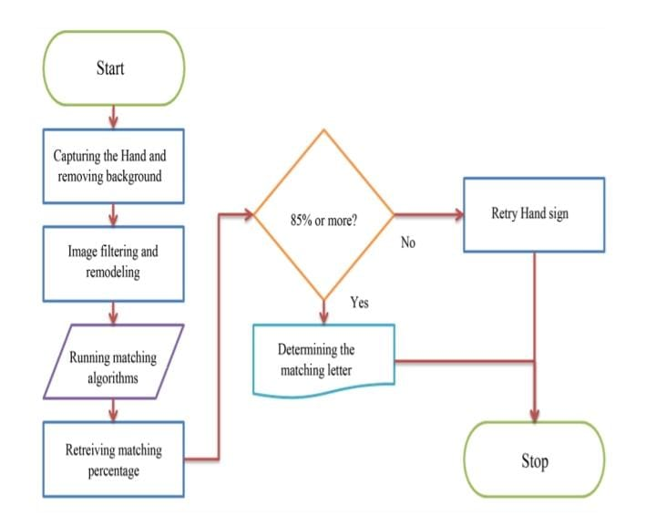
FLOW DIAGRAM

Slide 7
SIGNIFICANCE OF SIGN LANGUAGE
Primary language for the deaf and hard-of-hearing. • Culture: Integral to the cultural identity of the deaf community. • Development: Crucial for early cognitive and emotional growth in deaf children. • Education: Key to accessible learning for deaf individuals. • Equality: Recognition as an official language promotes legal and social rights. • Accessibility: Ensures equal access to information and services. • Interpreting: Vital for bridging communication gaps in various settings. • Technology: Advances in detection systems integrate the deaf community into the digital age. • Diversity: Adds to the richness of global linguistic variety. • Empathy: Encourages understanding and inclusivity in society.

Slide 8
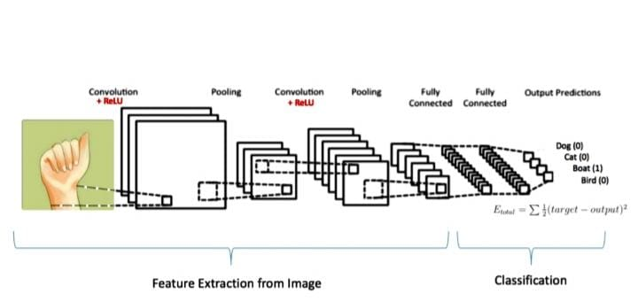
SIMULATION MODEL OF CONVOLUTION NEURAL NETWORK AND OVERALL ARCHIETECTURE

Slide 9
NEURAL NETWORK DESIGN
NEURAL NETWORK DESGIN: A neural network is basically modelled as the structure shown in figure2, in which can be observed a group of elements that interact to generate an output vector from an input vector which is described by the variable x. The training information is stored in the set of synaptic weight values of the neural network, and the output neuron is limited to a specific range of values of the activation function. 24 Output neuron can be described by
yk=ϕ(Σwki.xi+wo), (1) or yk= ϕ(vk) (2) where the subscript i indexes units in the input layer, k in the hidden; w ki denotes the input to hidden layer weights at the hidden unit k. An adder Σ which produces the weighted sum of inputs according to the respective weights of the connections. A activation function defines the output amplitude of that node given an input or set of inputs φ(vk), and wo is a threshold value

Slide 10
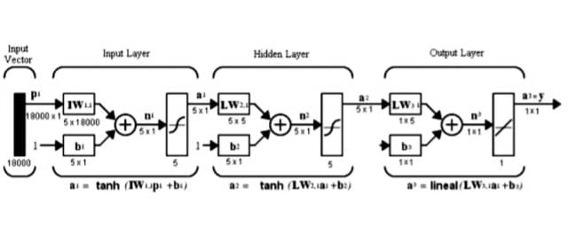
SIMULATION OF EMPLOYED MULTILAYER NEURAL NETWORK

Slide 11
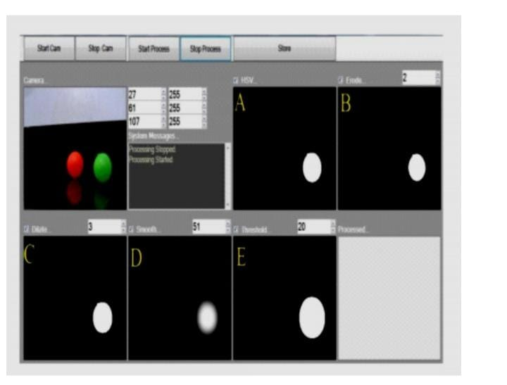
SIMULATION OF THRESHOLDING

Slide 12
HOG (HISTOGRAM OF GRADIENTS):
A feature descriptor is a representation of an image or an image patch which simplifies the image by extracting useful information and throwing away extraneous or non useful information.Hog is a feature descriptor which calculates a histogram of gradient for the image pixels, which is a vector of 9 bins (numbers ) to the corresponding angles such as 0, 20, 60... 160. These images are divided into cells, (usually, 8x8 ), and for each cell, by which gradient magnitude and gradient angle is calculated, using which a histogram is created for a cell. The histogram of a block of cells are normalized, and the final feature vector for the entire image is calculated.

Slide 13
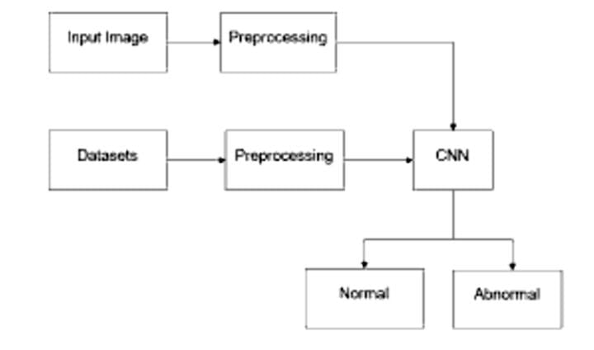
PRE TRAINING CNN MODEL

Slide 14
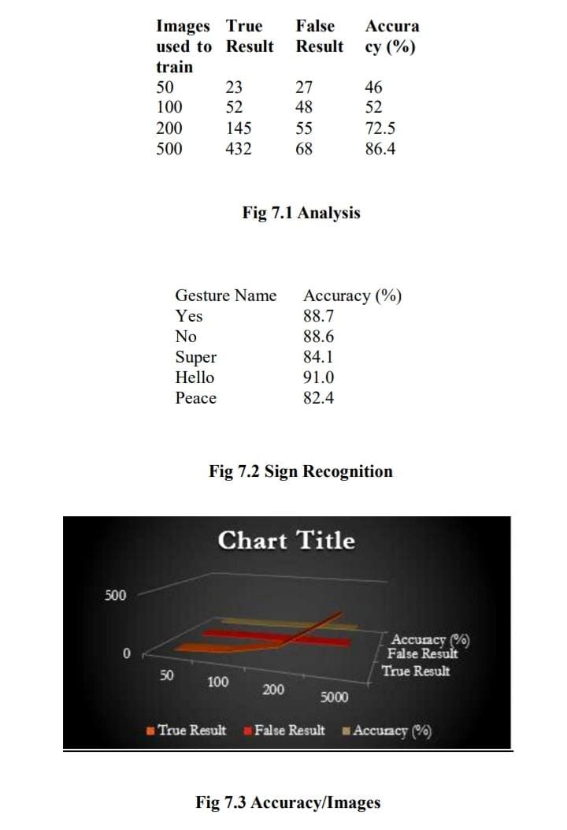
SIMULATION RESULTS

Slide 15
CONCLUSION
sign language detection technology enhances communication fluidity, enabling instantaneous translation of sign language into spoken oReal-timer written language and vice versa. Its integration into various platforms and devices empowers deaf individuals to participate more fully in social, educational, and professional contexts. As this technology matures, it has the capacity to revolutionize education and employment opportunities for the deaf community by breaking down communication barriers. The collaborative efforts of researchers, developers, and users are essential for refining and expanding the capabilities of sign language detection technology. By embracing and advocating for the continued development of such innovations, society can move closer to achieving true inclusivity and equality for individuals

Slide 16
Thank you

